Slide 1

The biology of COVID-19
KS3 – Lesson 2
Notes:
These lessons have been produced by the Institute for Research in Schools in partnership with the University of Bristol. The lessons aim to help students apply their studies to the Covid-19 pandemic, discovering important STEM career possibilities and applying mathematical principles to better understand the Covid-19 data available.

Slide 2

The biology of COVID-19
Outcomes
Explain what the R-number is
Make links between behaviour and the R-number
Apply what you know to manage a pandemic
Write a persuasive TV or radio advert to explain your strategy to control the virus.
The Institute for
Research in Schools
2

Slide 3

Watch this video. How does it relate to the R-number?
Notes:
This video was released in the USA to encourage people to socially distance from one another. The rate of ping pong balls being released is exponential.
The R-number would be the number of ping pong balls (infections) set off from the mousetraps (people) by the first ping pong ball (infection) arriving. With the mouse traps so close together, a single infection sets off many, which in turn each cause many, leading to a huge number of infections. The first bit of the film would be a good model for a disease spreading with a very high R rate.
When the mouse traps are spread out, an infection (ping pong ball) arriving does not set off an infection in any of the other traps.

Slide 4

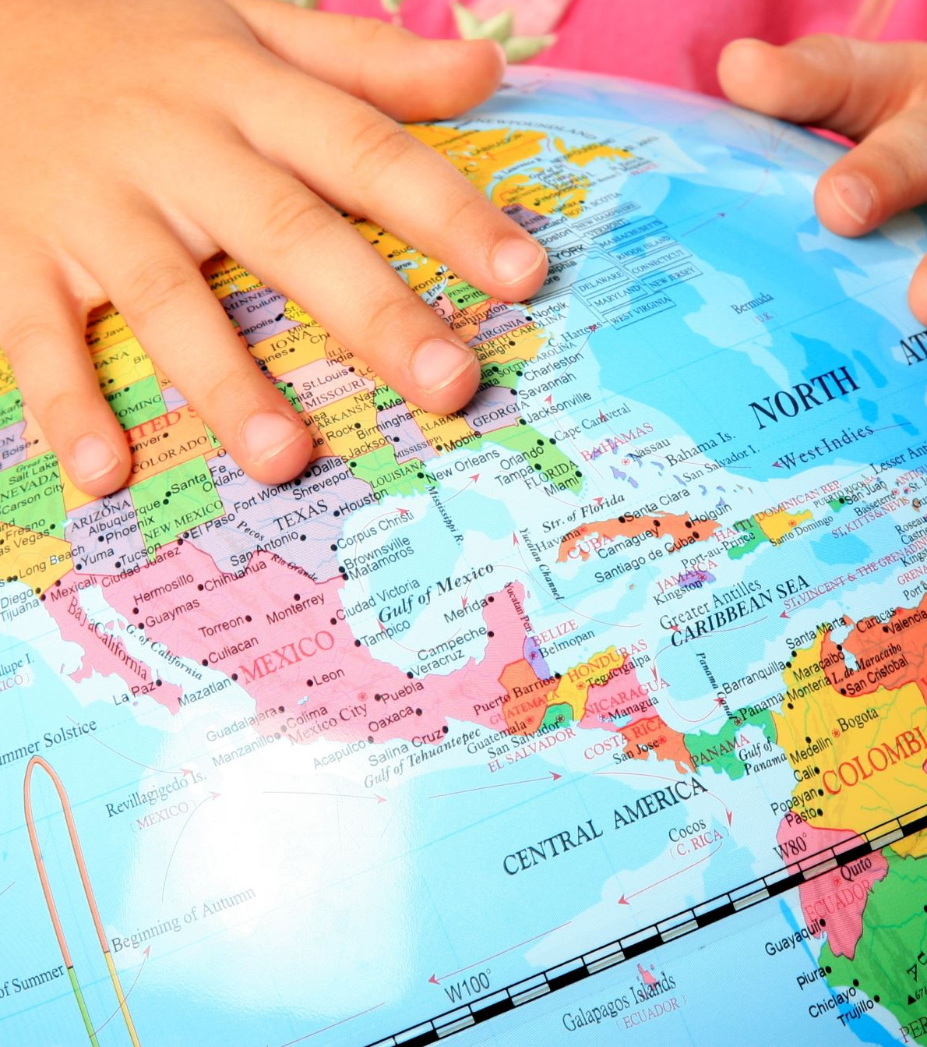

What do you remember?
INSERT PICTURE
What is the R-number?
Why does social distancing reduce the R-number?
Can you think of anything else that might reduce the R-number?
Reducing the R-number has been a vital tool in managing COVID-19
The Institute for
Research in Schools
4
Notes:
The R-number of disease spread is how many people a single person infects, on average.
Social distancing reduces the R-number by reducing the number of people a single infected person can spread the disease to.
There are lots of other things that can reduce the R-number. For example, reducing the numbers of people mixing with each other, increasing hand washing, isolating those who are ill. Can they think of more?

Slide 5

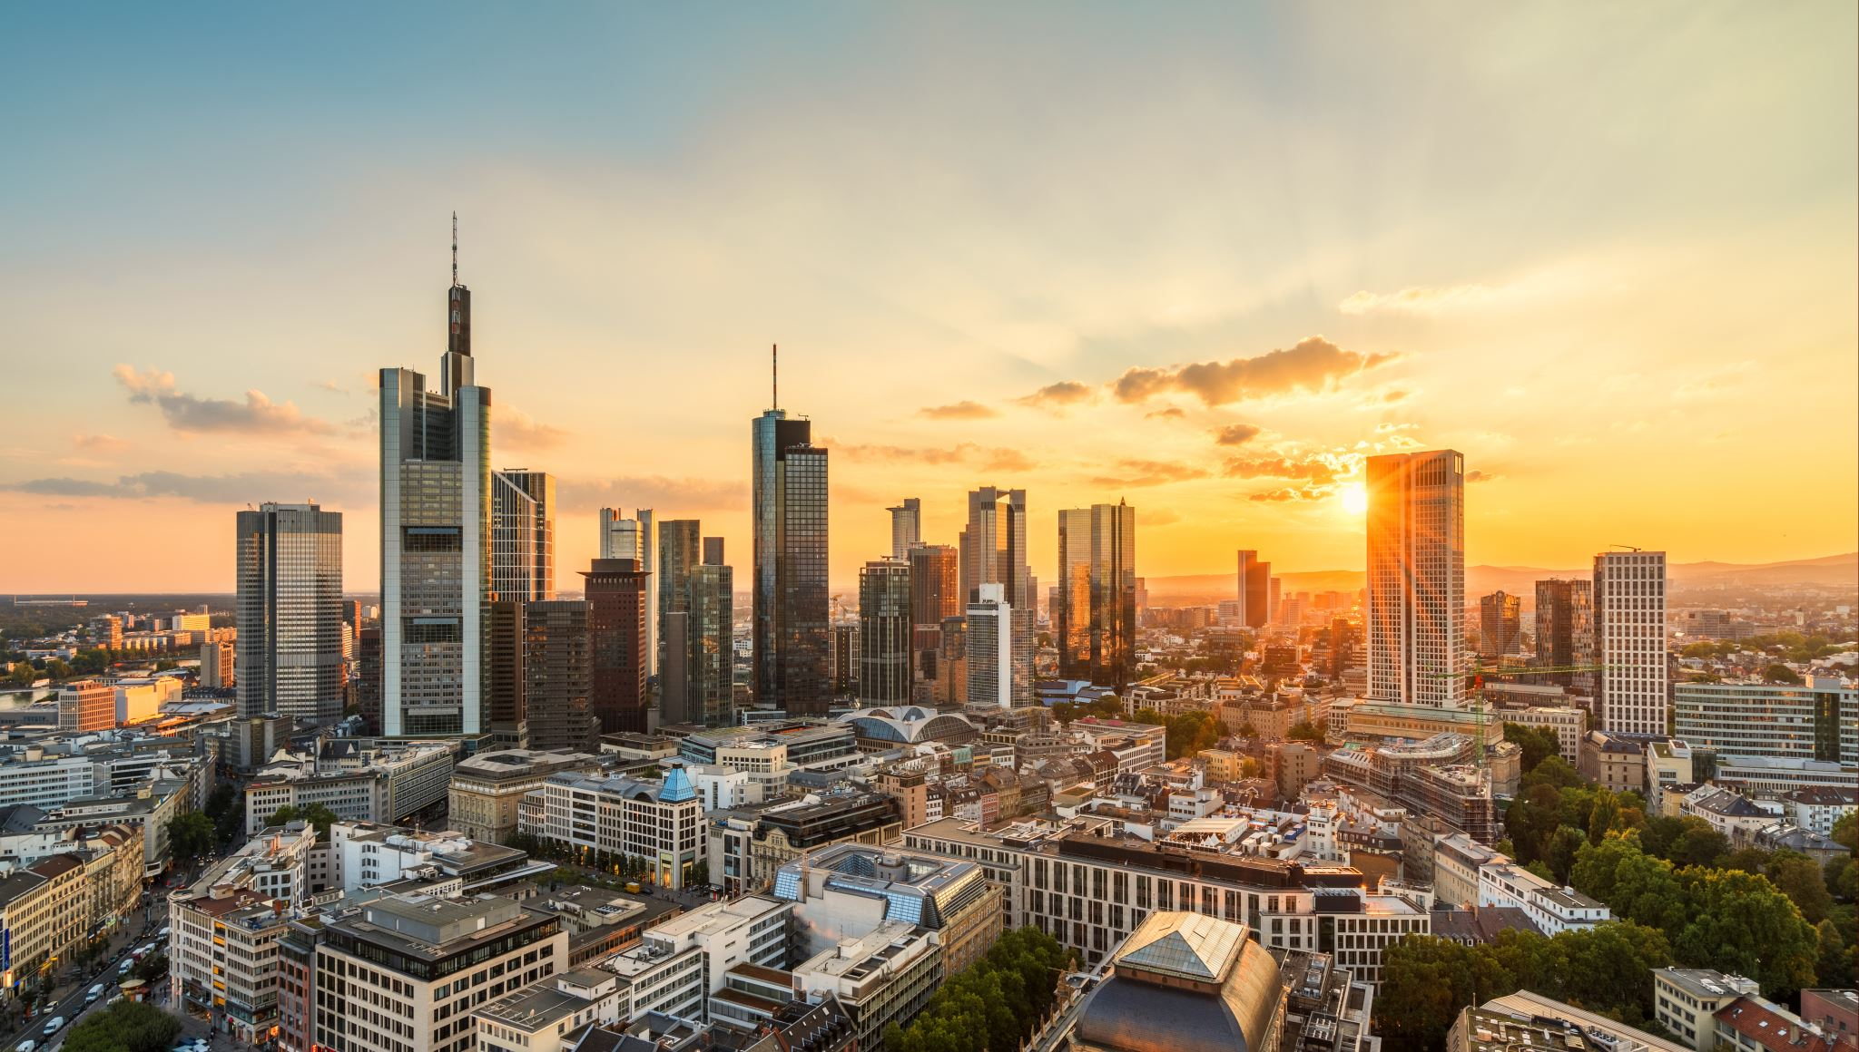
Scenario – Worksheet KS3.2
You are the City Leader of Green Plains, a large city in the UK. A disease has arrived in your city, and you must make decisions on how to manage it.
You have a small team to work with, and an information sheet.
You must decide what to do, then communicate this with your loyal citizens. Good luck!
INSERT PICTURE
Rapid, effective action is crucial in containing a fast-spreading disease
The Institute for
Research in Schools
5
Notes:
This activity is on Worksheet KS3.2

Slide 6

Presentations from the City Leader
INSERT PICTURE
The Institute for
Research in Schools
6
Notes:
Students (either individually or in small groups) present their ideas (in person or via online learning) on how to control the virus in their city. The marking criteria are found on Worksheet KS3.2

Slide 7
The biology of COVID-19
Outcomes
Explain what the R-number is
Make links between behaviour and the R-number
Apply what you know to manage a pandemic
Write a persuasive TV or radio advert to explain your strategy to control the virus.
The Institute for
Research in Schools
7

