Slide 1

The biology of COVID-19
KS4 – Lesson 1
Notes:
These lessons have been produced by the Institute for Research in Schools in partnership with the University of Bristol. The lessons aim to help students apply their studies to the Covid-19 pandemic, discovering important STEM career possibilities and applying mathematical principles to better understand the Covid-19 data available.

Slide 2

The biology of COVID-19
Outcomes
Know what a coronavirus is
Apply what you know about immunity to a novel pathogen
Learn about some of the scientists who are helping us to learn more about COVID-19
Be able to explain how mathematical modelling of disease spread can be useful
The Institute for
Research in Schools
2

Slide 3

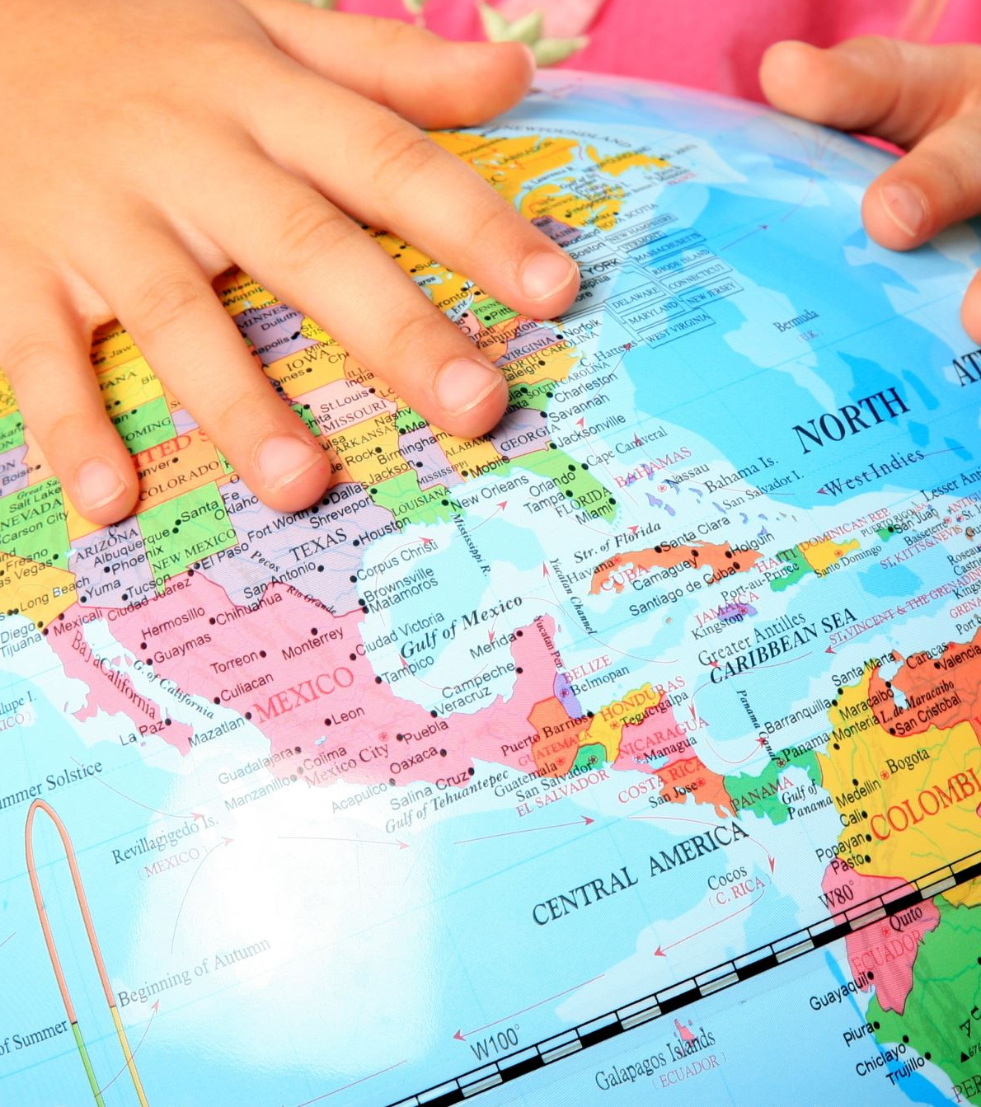
Pulling together in a pandemic
INSERT PICTURE
Task:
What is a pandemic?
How can scientists help in a pandemic?
Write a list of all the roles you can think of and how they help.
A pandemic needs a co-ordinated response to help to bring it under control.
The Institute for
Research in Schools
3
Notes:
This can be discussion that is teacher-led, either in person or on an online platform, or students can do this independently, making their own notes on the lesson. Encourage students to think more deeply than frontline medical staff; the outcomes should have given hint at the response of scientists goes a lot further than that.

Slide 4


)
Scientists who help in a pandemic include …
Frontline Medical staff
Laboratory technicians
Hospital pharmacists
Infectious disease epidemiologists
Statisticians
Computer modellers
Vaccine developers
Vaccine producers
Molecular epidemiologists
Public Health Officials
Logisticians
Mathematicians
INSERT PICTURE
A team of scientists with different skills are needed to solve a complex problem such as managing a pandemic
The Institute for
Research in Schools
4
Notes:
Students may have thought of additional scientists who help during a pandemic – there are many more. Encourage discussion about this to broaden out their assumptions about jobs in STEM.

Slide 5

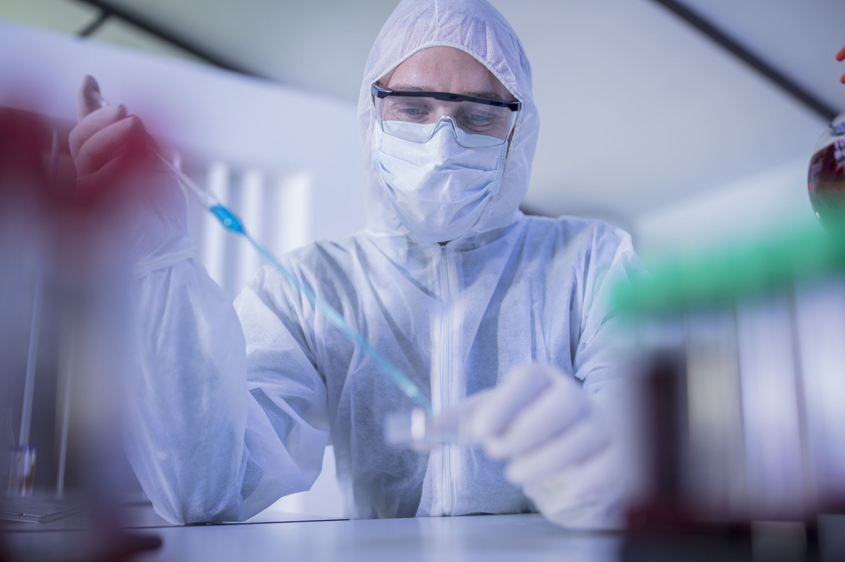
Epidemiologists study health and disease amongst people. They help to deliver public health services and respond to biological threats to the human population. There are many types – here are two:
INSERT PICTURE
INSERT PICTURE
Infectious disease epidemiologists look at the effect of the disease on the population. They can use big data and mathematical models to make predictions about how many people might be infected.
Infection control epidemiologists will work to understand the disease and recommend most appropriate control measures to control the immediate spread.
The Institute for
Research in Schools
5
Notes:
Can students think of examples of how they have seen these people work in the past year? Examples include the modelling of the spread of Covid-19 that was used by Professor Chris Whitty on the televised Covid-19 updates. Infection control epidemiologists will have advised on what Personal Protective Equipment (PPE) was required to minimise the spread of the virus.

Slide 6


Insert running header (PowerPoint Title)
How do we know a new disease has arrived and is spreading?
Scenario
You are a General Practitioner (Doctor) in a village surgery in the North East of England.
One week you have six patients coming to your surgery with the same unusual combination of symptoms. They seem quite ill but it isn’t something you have seen before.
What do you do? Who do you speak to?
INSERT PICTURE
GPs are often on the front line of identifying a new illness amongst the population
The Institute for
Research in Schools
6
Notes:
Students are asked what they would do if they were a GP who had identified a new illness. They should come round to the idea that there needs to be a coordinated system of reporting such diseases (and others, known as ‘notifiable’ diseases) so that monitoring of the population can be carried out, and steps taken to identify and limit the spread of any new disease. They may already be familiar with the organisation called ‘Public Health England’ who are responsible for preparing for and responding to public health emergencies.

Slide 7
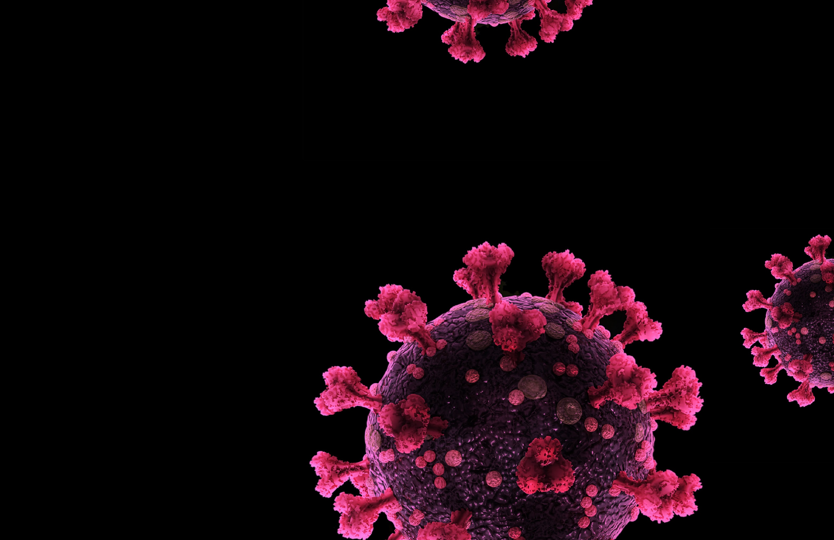
COVID-19 as a disease
COVID-19 is the disease caused by a novel (newly identified) coronavirus (SARS-CoV-2).
Coronaviruses are a family of viruses that cause illness in humans and animals.
Seven different types of coronaviruses have been found in people, including those causing the common cold, SARS, MERS and Covid-19.
INSERT PICTURE
A coronavirus such as SARS-CoV-2 that causes COVID-19 looks a bit like a crown (or corona) when viewed under a microscope.
The Institute for
Research in Schools
7
Notes:
There are three key points here – COVID-19 is the disease caused by the novel coronavirus SARS-CoV2; there are several coronaviruses already known, including the one that causes the common cold; SARS-CoV2 is new to us – we haven’t seen it before.

Slide 8
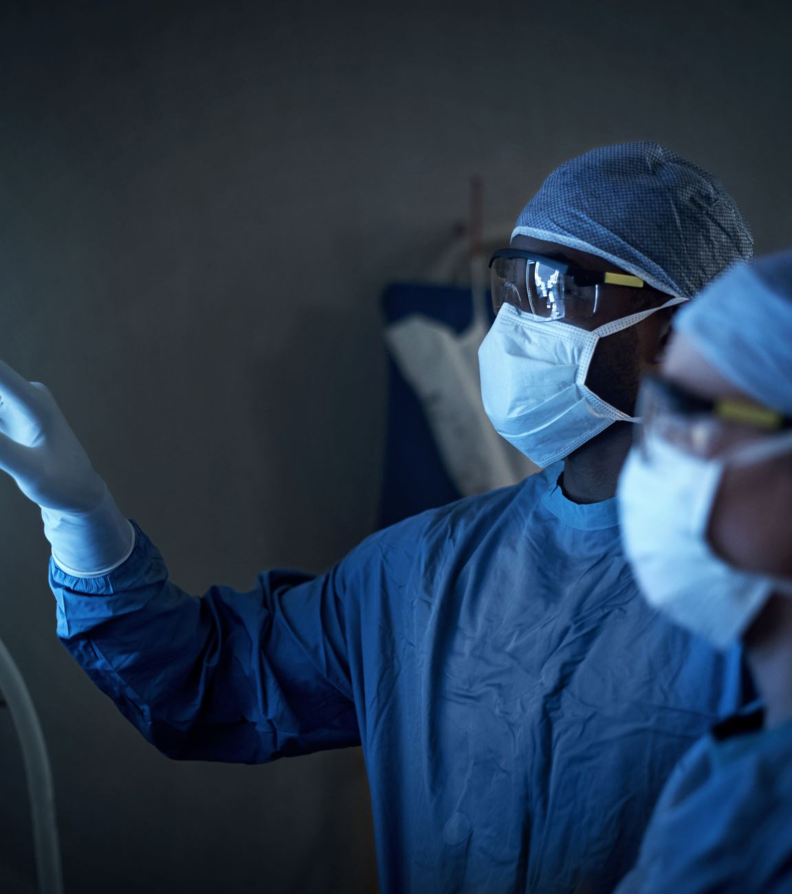
Why do novel illnesses cause such problems?
INSERT PICTURE
Task:
Use ideas about:
The immune system
Knowledge of treatment
Knowledge of symptoms
to explain why novel illnesses are a particular problem.
Novel illnesses can cause more problems than ones we have encountered before.
The Institute for
Research in Schools
8
Notes:
This is a writing task; it can be used as practice for a longer-answer examination question if required. Novel illnesses are a particular problem because: The immune system has no memory cells for a new virus that it has not encountered before. This means that the first time it is encountered, the response of the immune system may be slow and not as extensive as if it a previously encountered pathogen. If a disease is new to us, medical professionals may not know what the best treatments are and may not recognise the symptoms. With a new disease, there is the further problem that, as nobody in the population is immune to it, it can spread very quickly.

Slide 9
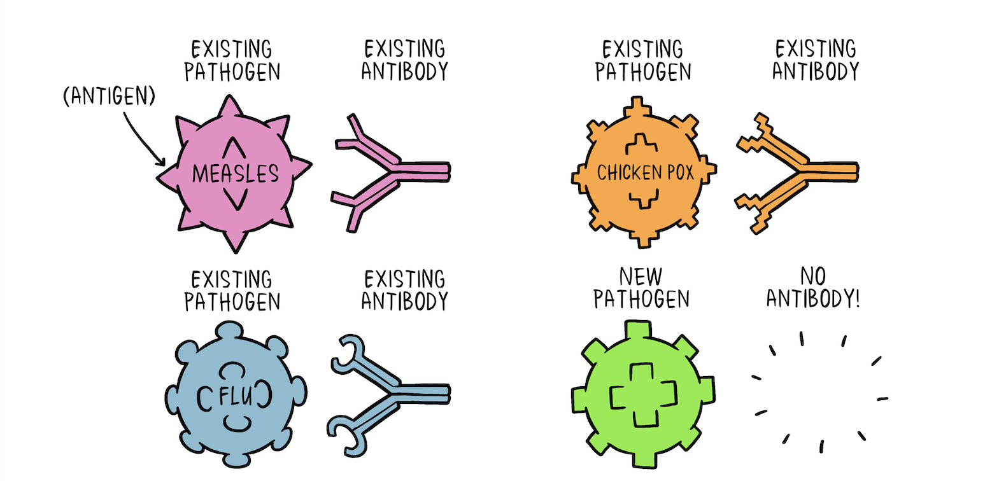
World Health Organisation, 2020
The immune system has no memory cells for a new virus that it has not encountered before. This means that the first time it is encountered, the response of the immune system may be slower and not as extensive. Vaccination can help to overcome this. How?
Notes:
Novel pathogens are more difficult for the body to deal with as the body cannot recognise the pathogen. Vaccination introduces a weakened version or part of the pathogen to the body so that the immune system recognises it if it encounters it again. You may wish to use this part of the lesson for a brief review of the immune response.

Slide 10
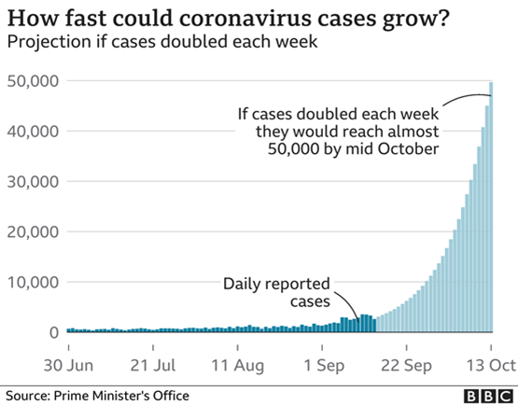
Information about pandemic spread
INSERT PICTURE
What does this graph show?
What date do you think it was produced?
How was the data obtained?
How could this data be used?
The Institute for
Research in Schools
10
Notes:
Make sure you look at the title, the source, the annotations and consider each of the questions.

Slide 11
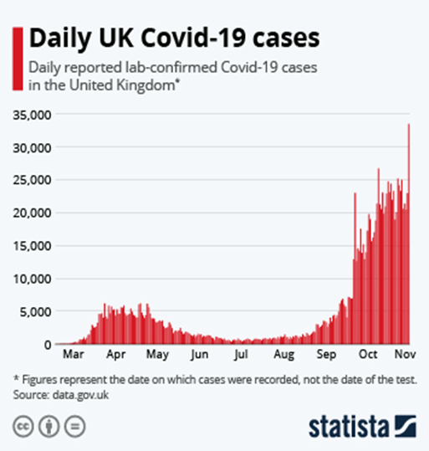
Information about pandemic spread
INSERT PICTURE
What does this graph show?
What date do you think it was produced?
How was this data obtained?
How could this data be used?
The Institute for
Research in Schools
11
Notes:
Make sure you look at the title, the source, the annotations and consider each of the questions.

Slide 12


Data analysis and using models to make predictions
How are these graphs different?
How are they the same?
The Institute for
Research in Schools
12

Slide 13
Feedback – how are the graphs different and how are they the same?
Different
One has used real data, the other starts with real data but then predicts what might happen
The data (numbers) are different – in what way?
The purposes of the graphs are different – what is the purpose of each graph?
Same
Both graphs look at death rates from COVID-19
Both graphs show a large increase in deaths from COVID-19 from September - October
Why is it useful to use models to make predictions? What do we have to be aware of when using models for disease spread?
The Institute for
Research in Schools
13
Notes:
The data is different between the two graphs because the reality was not as serious in terms of deaths as the modelled predictions. The purpose of the modelled graph was to inform the public about the reasons that decisions were being made. The predictions were higher than the deaths in reality. This may be because the population made behavioural changes due to the Tier system being introduced.

Slide 14

Extension task
Sheet KS4.1
INSERT PICTURE
This task asks you to apply what you have learnt to answer some questions about Covid-19
The Institute for
Research in Schools
14

Slide 15
The biology of COVID-19
Outcomes
Know what a coronavirus is
Apply what you know about immunity to a novel pathogen
Learn about some of the scientists who are helping us to learn more about COVID-19
Be able to explain how mathematical modelling of disease spread can be useful
The Institute for
Research in Schools
15

